Slide 1
One language to rule them all
Infrastructure as code in F#
Stefano d’Antonio
https://github.com/unosd
https://uk.linkedin.com/in/stefanodantonio

Slide 2


Four languages to develop them
Web application development
HTML
CSS
JavaScript
F# (backend)
Fable
Elmish

Slide 3
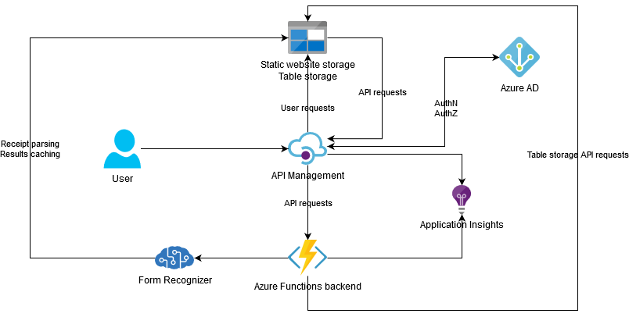
In the land of the cloud where the shadows lie
Cloud hosting introduced also a requirement for scripting deployment automation

Slide 4

Seven languages to cloud them
Infrastructure as code
JSON ARM templates
CloudFormation
Cloud Deployment Manager
Terraform
PowerShell
Azure CLI
Bash
…and more
Pulumi

Slide 5
What’s Pulumi?
IaC tool
Open source
Cross platform
Multi-cloud
Uses general purpose languages
Now supports .NET

Slide 6
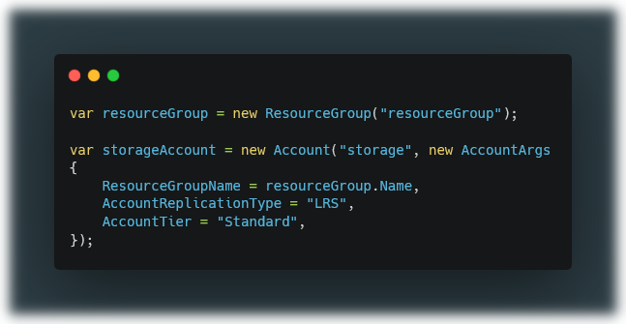
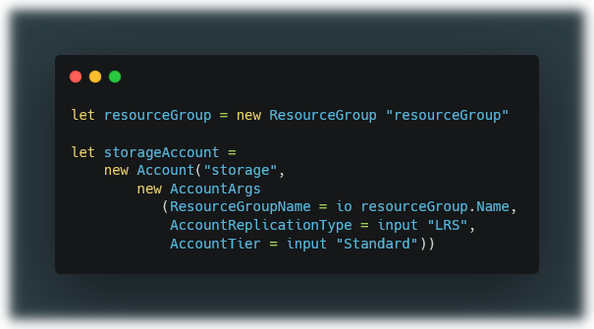
Pulumi C# vs F#

Slide 7
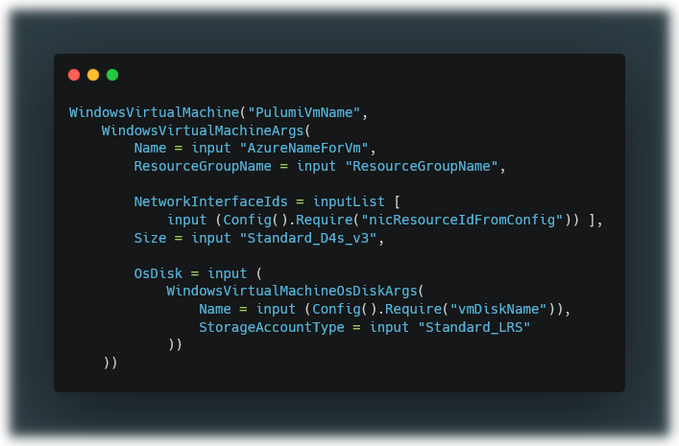
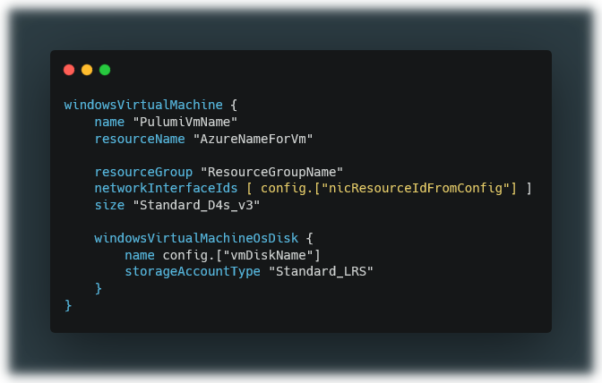
Before…
After (with Pulumi.FSharp.Extensions)

Slide 8
How is it built?
Custom computational expressions for each Pulumi resource and type
Custom operations overloads for each input type to avoid implicit casting
Nested computational expressions for complex types
Auto-generation of code from Pulumi JSON schema using Myriad and F# AST

Slide 9

Full stack F#
Develop/design
Build/deploy

Slide 10
Thank you for watching
My GitHub -> https://github.com/unosd
My LinkedIn -> https://uk.linkedin.com/in/stefanodantonio
Project -> https://github.com/UnoSD/Pulumi.FSharp.Extensions
NuGet -> https://www.nuget.org/packages/Pulumi.FSharp.Azure (and .Aws and more)
I’m also on the F# and FP Slack as uno/unosd

